Slide 1
Social Network Analysis of a Twitter Dataset
Rohan Nitin Khandke
Bavinkumar Ravikumar
Manan Pranav Desai

Slide 2
INTRODUCTION
Social Network Analysis (SNA) is a powerful tool used to study the social structures and relationships between individuals or groups.
Brief overview of the project: This project aims to analyze sentiment towards ISIS on Twitter to understand ideological trends and information diffusion within the network.
Importance of understanding sentiment towards ISIS on Twitter: Social media platforms like Twitter play a significant role in shaping public discourse and opinions. Analyzing sentiment on Twitter provides insights into public perceptions and attitudes towards specific topics.

Slide 3
OBJECTIVE
The primary objective of this analysis is to identify primary sources of ideology towards ISIS and track how that ideology spreads within the network of Twitter users.
The analysis will be conducted using a combination of data collection ,sentimental analysis ,network analysis and visualization techniques.

Slide 4
PROBLEM STATEMENT
Description of the problem statement: The task involves analyzing tweets related to ISIS to identify the primary sources of ideology towards the group and track how that ideology spreads within the network of Twitter users.
The need to identify primary sources of ideology towards ISIS: Understanding the origin and propagation of ideological trends is crucial for policymakers, researchers, and social media platforms to address misinformation, polarization, and other societal challenges.

Slide 5
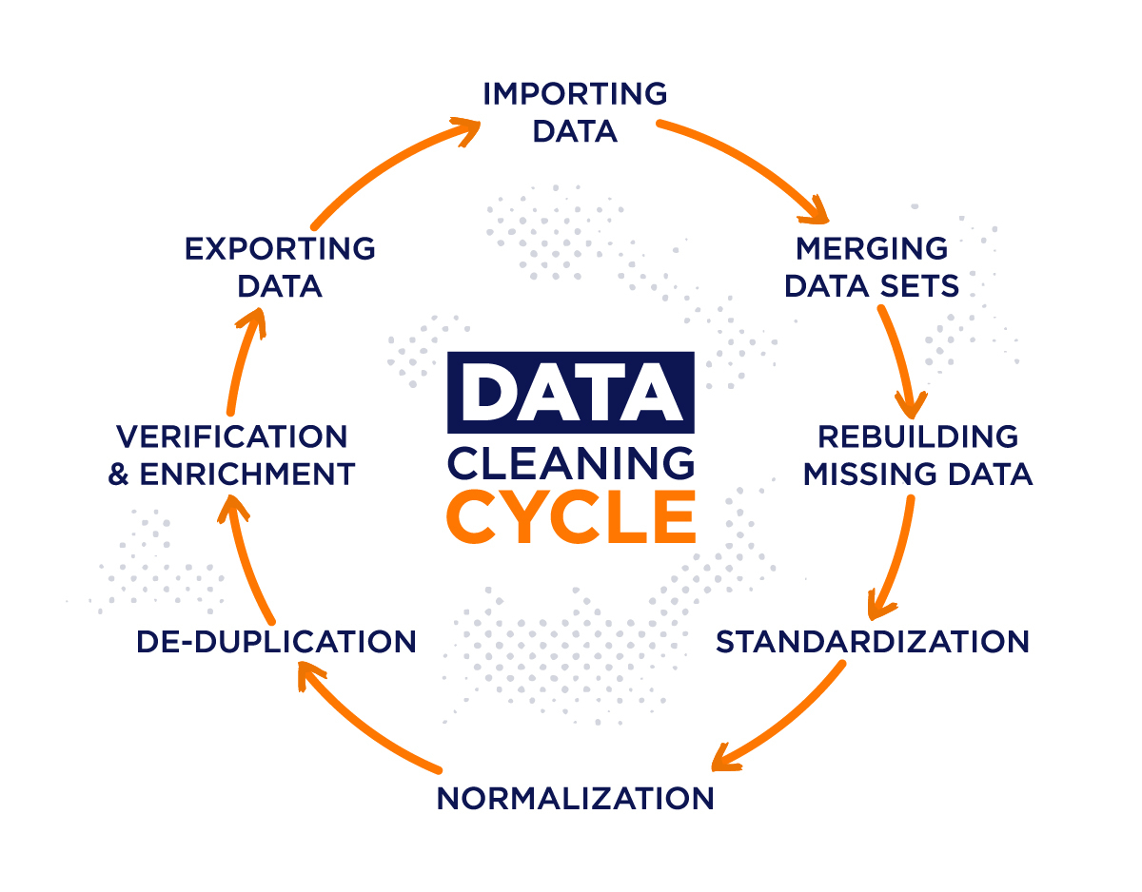
DATA COLLECTION
We will collect a Twitter dataset using the Twitter API, filtered by relevant keywords, hashtags, and users. The data collection period will be limited to a specific time frame, such as a week or a month, to ensure that the analysis captures recent and relevant data.
DATA CLEANING
The collected data will be pre-processed to remove any duplicate or irrelevant tweets, and to extract the relevant network data such as users, mentions, and retweets.

Slide 6
METHODOLOGY
Sentiment Analysis: We will perform sentiment analysis on the tweet data using the VADER sentiment analyzer, a lexicon and rule-based tool specifically designed for sentiment analysis in social media text. Tweets will be classified as expressing positive, negative, or neutral sentiment towards ISIS.
Visualization: The graph will be visualized using the NetworkX and Matplotlib libraries in Python. We will customize the visualization to differentiate nodes based on their sentiment category (positive, negative, or neutral) and attribute values (e.g., node size and color).
Interpretation: We will interpret the results of the graph analysis to gain insights into the spread of sentiment towards ISIS within the Twitter network. This will involve identifying primary sources of ideology, tracking the diffusion of sentiment, and understanding the role of influential users in shaping discourse.

Slide 7
Sentiment Analysis
Sentiment analysis is a natural language processing technique used to classify the sentiment of text data into categories such as positive, negative, or neutral.
Use of natural language processing techniques to classify sentiment: We utilize tools like the VADER sentiment analyzer to automatically classify tweets as expressing positive, negative, or neutral sentiment towards ISIS.
Examples of tweets expressing different sentiments towards : Positive sentiment tweets may include messages of support or admiration, while negative sentiment tweets may contain criticism or opposition.

Slide 8
GRAPH REPRESENTATION
Visualizing sentiment analysis results as a graph: We represent the positive sentiment analysis results as a graph, where nodes represent Twitter users and edges represent interactions between users.

Slide 9
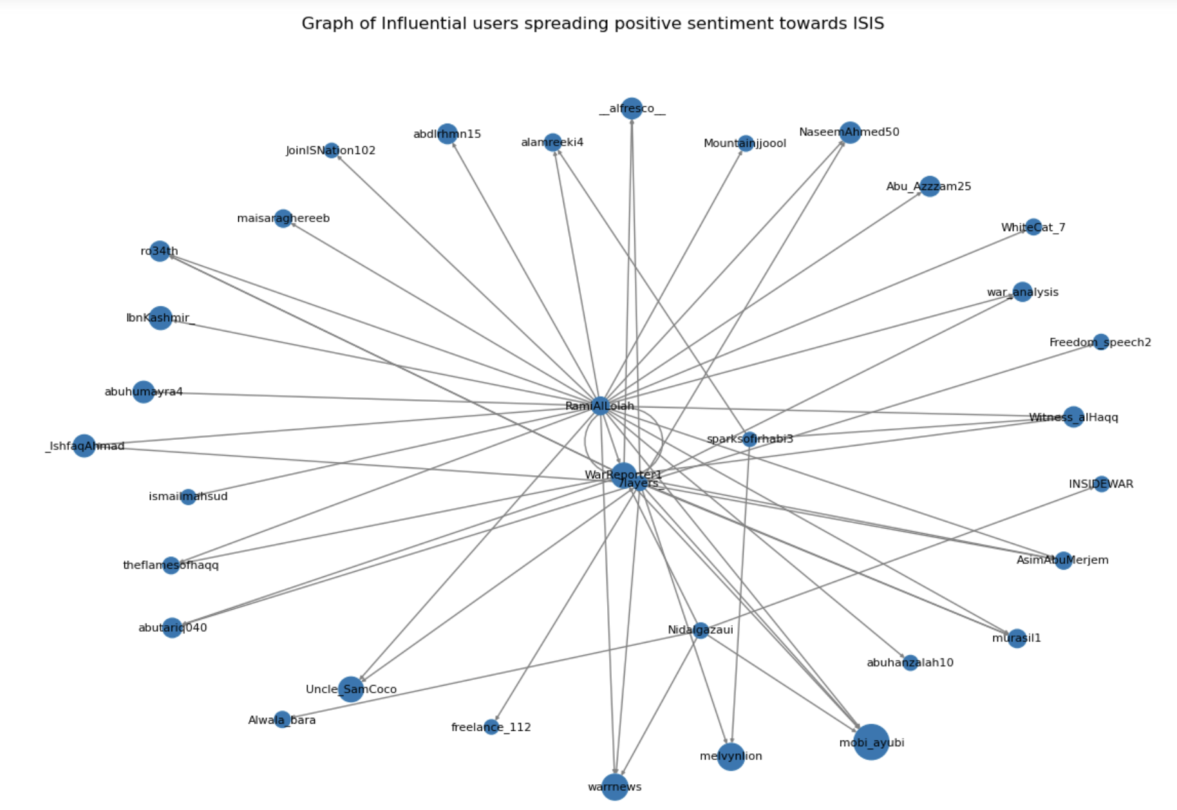

Slide 10
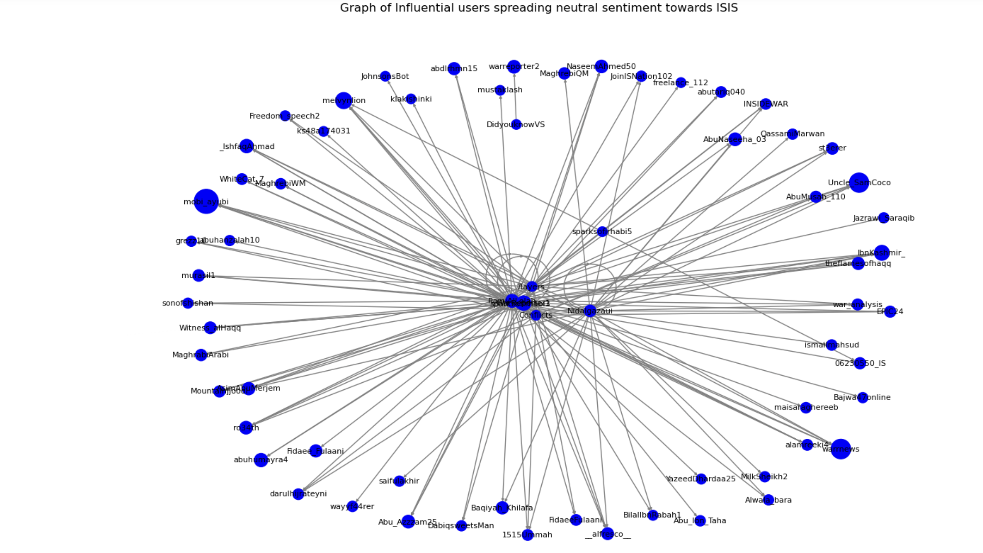

Slide 11
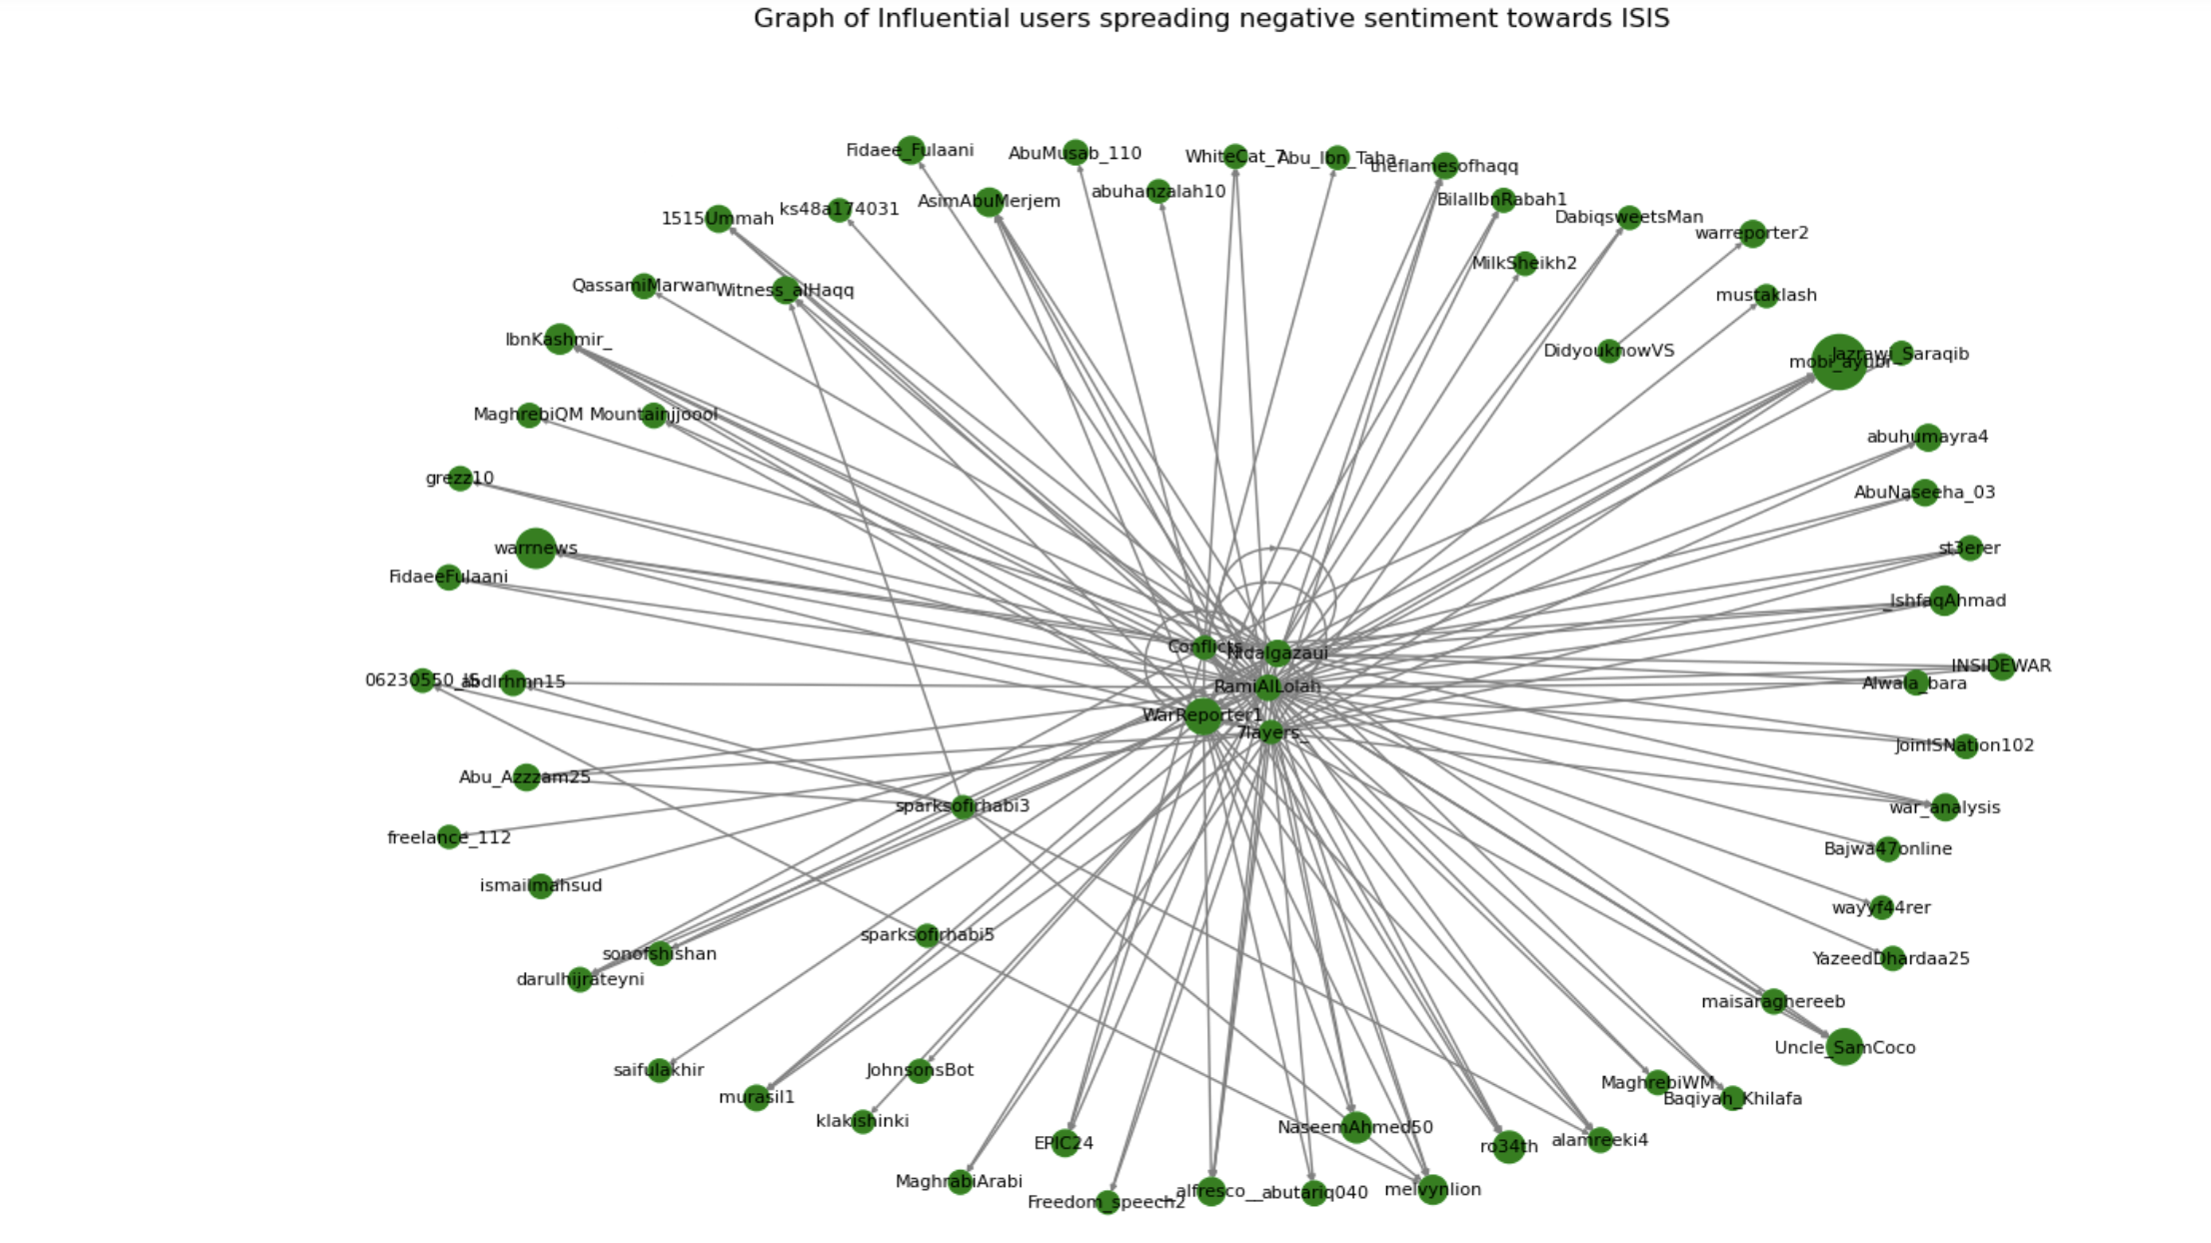

Slide 12
GRAPH ANALYSIS
Interpretation of the graph: We analyze the graph to identify primary sources of positive sentiment towards ISIS and track the spread of sentiment within the network of Twitter users.
Identifying primary sources of positive sentiment towards ISIS: We focus on nodes with the highest degree of connectivity and influence within the network.
Tracking the spread of sentiment: By examining the receiver nodes connected to the primary sources, we can track how sentiment towards ISIS propagates within the network.

Slide 13
CONCLUSION
Recap of the objectives and methodology: We provide a brief recap of the objectives of the analysis and the methodology used to achieve them.
Importance of the analysis in understanding public sentiment towards ISIS: We highlight the significance of the analysis in understanding public perceptions and attitudes towards ISIS Twitter.
Implications for policymakers and researchers: We discuss the potential implications of the analysis for policymakers, researchers, and social media platforms in addressing misinformation, polarization, and other societal challenges.

Slide 14
FUTURE WORK
Possible extensions or improvements to the analysis: We suggest areas for future research and potential enhancements to the analysis methodology.
Suggestions for further research in the field of sentiment analysis and social network analysis: We propose avenues for further investigation to deepen our understanding of ideological trends and information diffusion on social media platforms.

